Slide 1


CVP Intelligence
Smart Cost–Volume–Profit Analysis System
A Web-Based Short-Term Decision-Making Tool
Group Assignment
Cost & Management Accounting (MF2222)
Faculty of Computing
Department of Computational Mathematics
General Sir John Kotelawala Defence University

Slide 2

Table Of Content
Introduction to CVP Analysis
The Problem Statement
The Solution: CVP Intelligence
Core Features
Technology Stack
System Architecture
How CVP Intelligence Enhances Efficiency
Revenue Model
Real-World Business Impact
Conclusion & Future Roadmap

Slide 3

Introduction to CVP Analysis
What is CVP Analysis?
• A management accounting tool to understand the relationship between Costs, Volume, and Profit.
Key Objectives:
• Determine the Break-even Point (Zero Profit/Loss).
• Guide pricing strategies.
• Calculate the Margin of Safety.
• Perform What-If analysis for strategic planning

Slide 4

The Problem Statement
Current Industry Challenges:
Manual Complexity:
Calculations are tedious and prone to human error.
Data Fragmentation:
Information is often scattered across multiple spreadsheets.
Lack of Real-time Insights:
Slow reaction to market changes.
Predictive Gap:
Difficulty in visualizing the future impact of today's decisions.

Slide 5

The Solution: CVP Intelligence
Vision:
A centralized, intelligent platform for financial planning.
Value Proposition:
• Simplifies complex accounting for non-experts.
• Provides real-time, visual data representation.
• Leverages AI to provide actionable business insights.
• Completely web-accessible and cloud-synced.
Live System: https://cvpintelligence.online/

Slide 6
CORE FEATURES

Slide 7
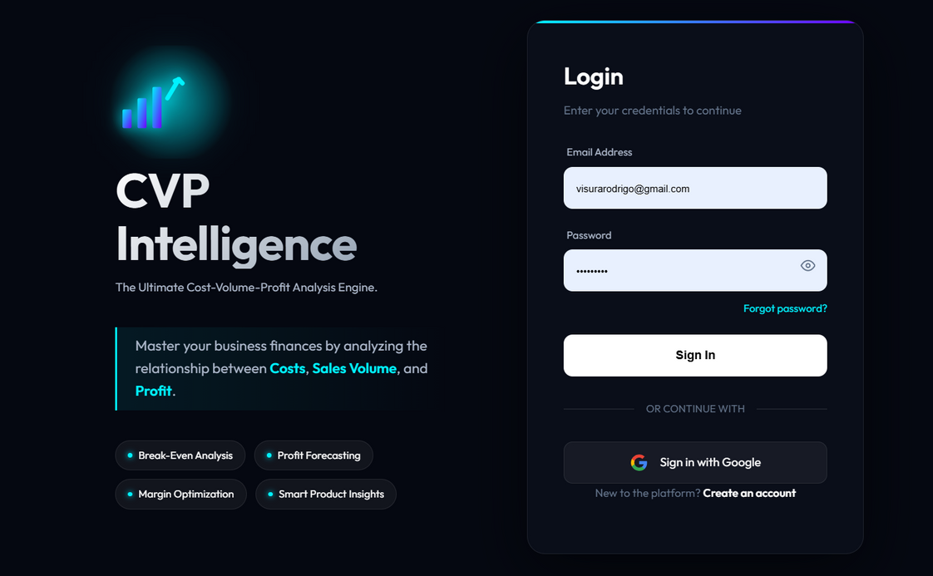
1.Secure Login & User Access
Provides secure user authentication to access the CVP Intelligence platform.
Supports email/password login with encrypted credentials.
Optional Google sign-in for quick and convenient access.
Integrated Modules

Slide 8
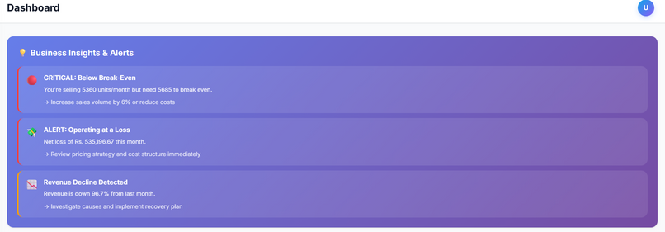
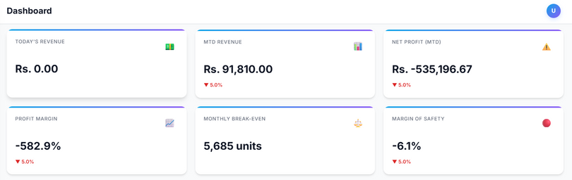
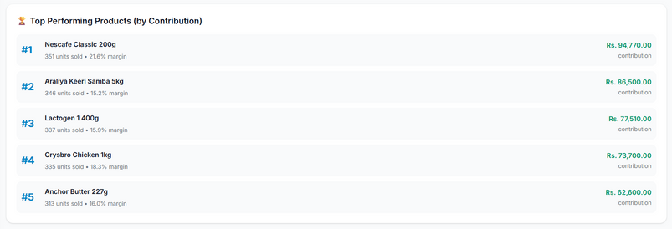
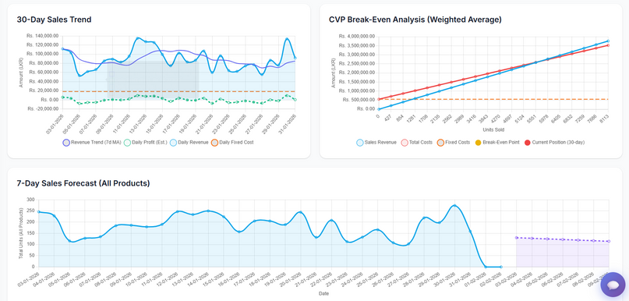
2. Smart Business Dashboard
Centralized overview of business performance
Displays revenue, profit, break-even, and alerts
Highlights risks like losses and revenue decline
Shows top-performing products and trends
Supports quick managerial decision-making

Slide 9
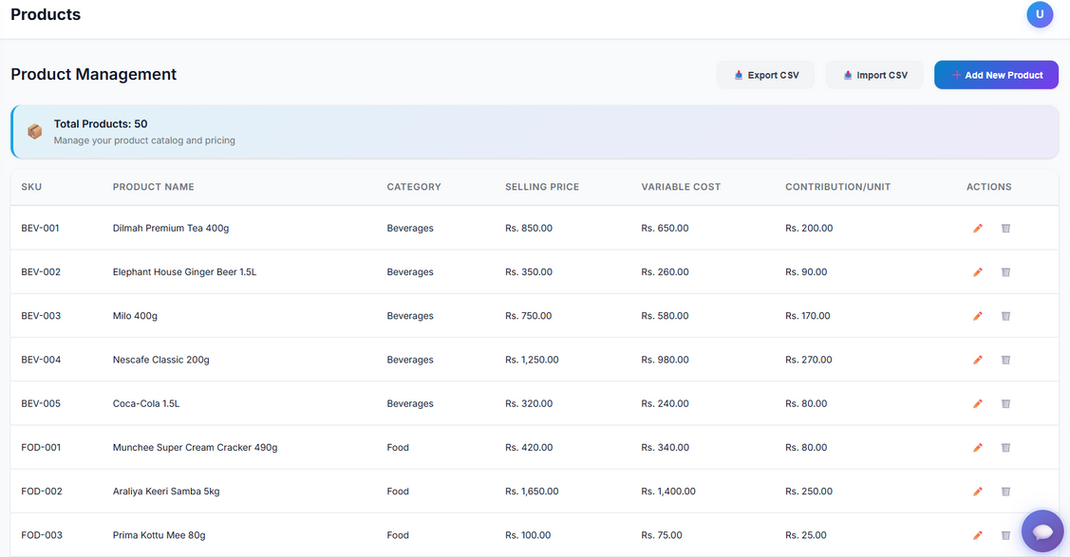
3.Product Management & Contribution Analysis
Manage product details and pricing
Calculates contribution per unit automatically
Categorizes products for analysis
Supports CSV import and export
Ensures accurate CVP calculations

Slide 10
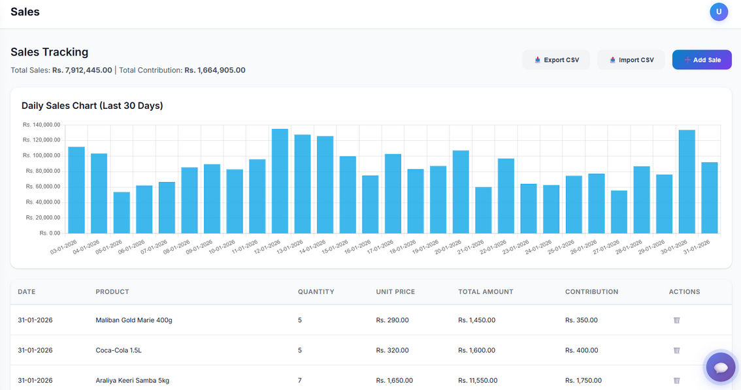
4.Sales Tracking & Revenue Analysis
Records daily sales transactions
Displays last 30-day sales trends
Calculates total revenue and contribution
Helps monitor product-wise performance
Eliminates manual sales tracking

Slide 11
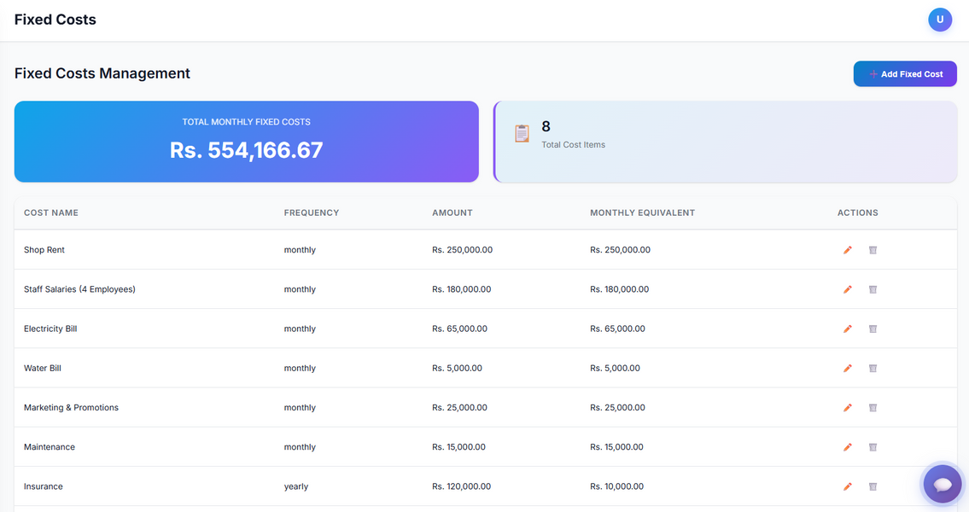
5.Fixed Cost Management & Monthly Cost Structure
Records all recurring fixed costs
Converts yearly costs to monthly values
Calculates total monthly fixed cost
Supports accurate break-even analysis
Improves cost visibility and control

Slide 12
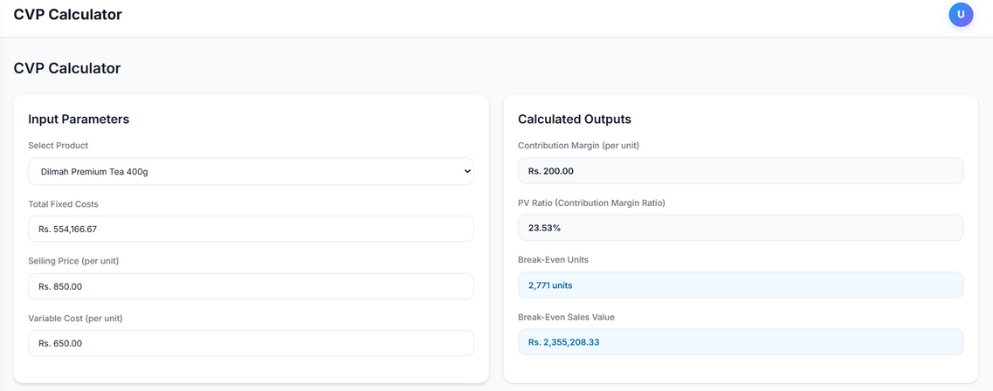
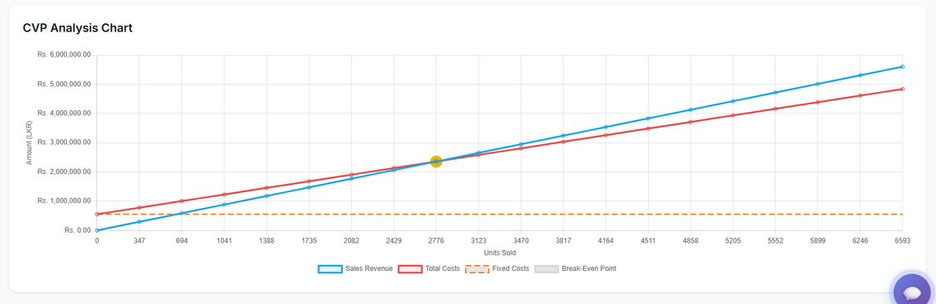
6.CVP Calculator & Break-Even Analysis
Calculates contribution margin and PV ratio
Computes break-even units and sales value
Uses real business data inputs
Displays results instantly
Visualizes CVP relationships with charts

Slide 13
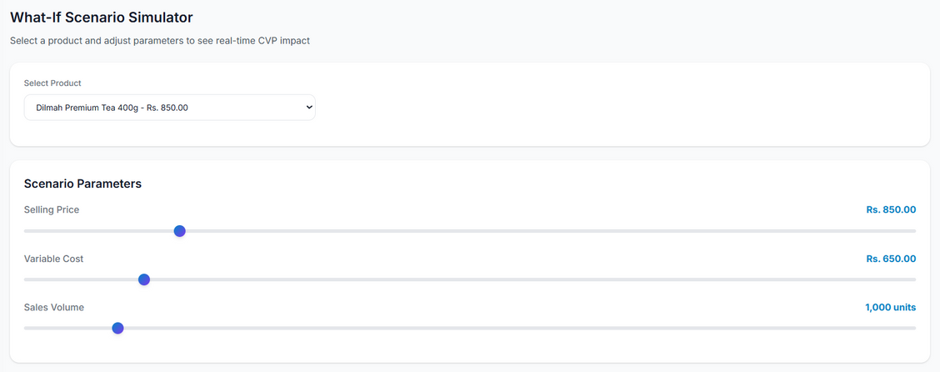
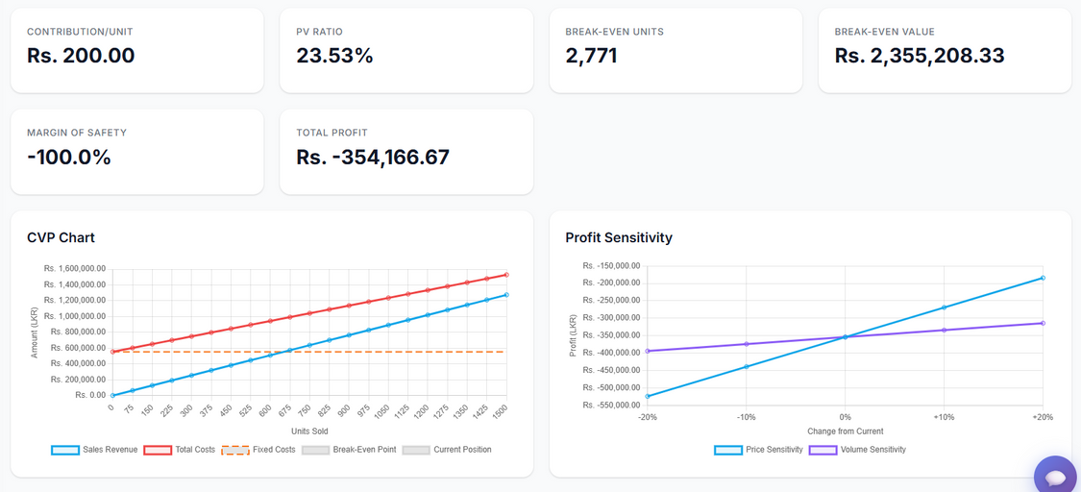
7.What-If Scenario Simulator & Profit Sensitivity Analysis
Simulates pricing, cost, and volume changes
Shows real-time impact on profit and break-even
Displays margin of safety and total profit
Includes sensitivity analysis charts
Supports scenario-based decision making

Slide 14
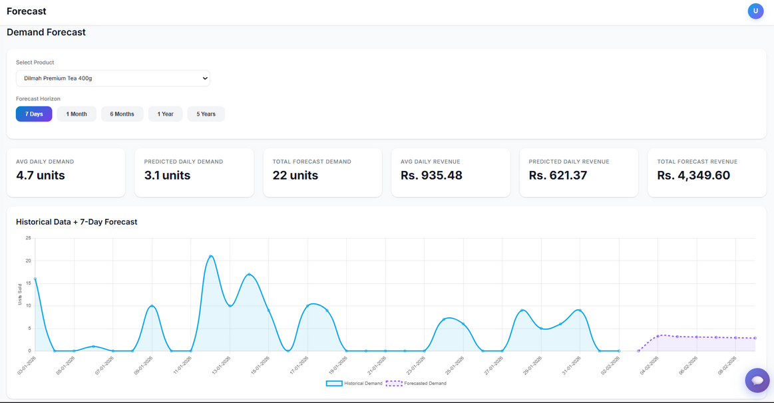
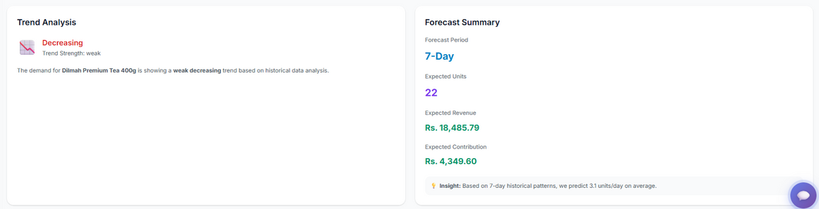
8.Demand Forecasting & Trend Analysis
Predicts future product demand
Supports multiple forecast horizons
Calculates expected revenue and contribution
Analyzes demand trends
Assists short-term and long-term planning

Slide 15
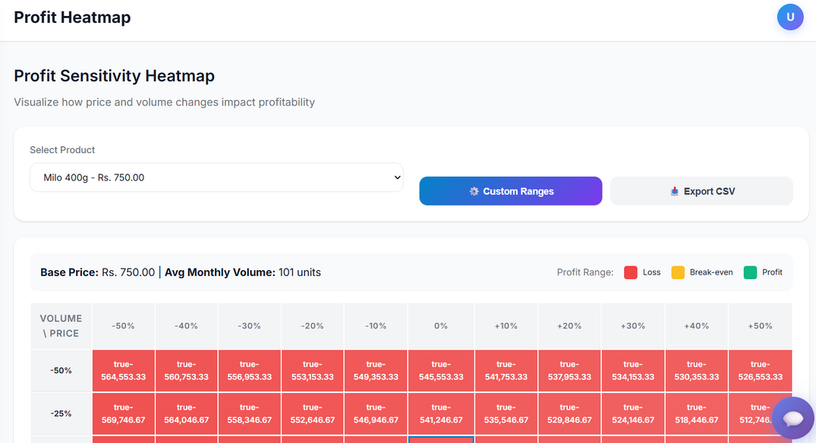
9.Profit Sensitivity Heatmap
Visualizes profit across price and volume changes
Highlights loss, break-even, and profit zones
Helps identify profitable ranges quickly
Supports strategic pricing decisions
Simplifies sensitivity analysis

Slide 16
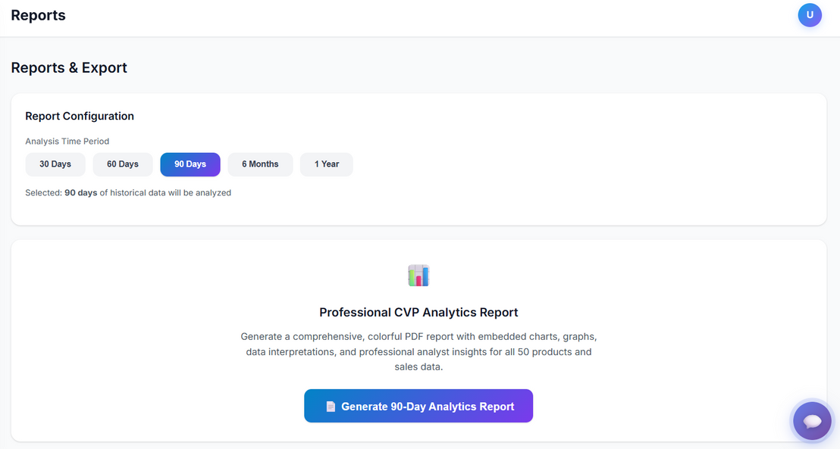
10.Professional CVP Analytics Reports
Generates professional CVP analytics reports
Includes charts, summaries, and insights
Supports multiple time periods
Exports reports as PDF
Suitable for academic and business use

Slide 17
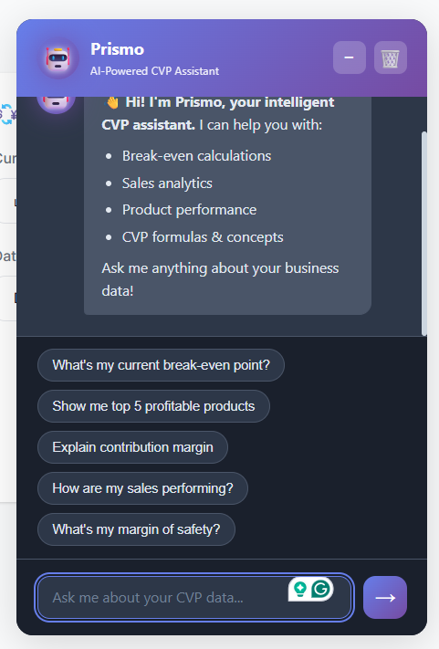
11.AI-Powered CVP Assistant – Prismo
AI-powered CVP support assistant
Explains CVP concepts in simple terms
Answers break-even and profit questions
Provides instant business insights
Enhances learning and decision-making

Slide 18
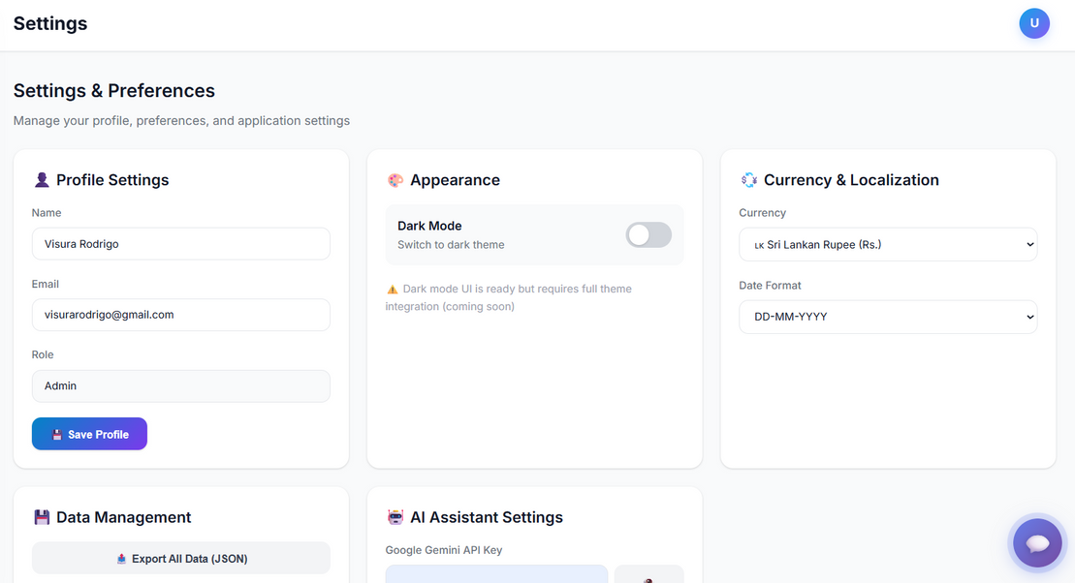
12.System Settings & Preferences
Manages user profile details
Supports currency and date localization
Enables theme customization
Allows data export
Improves user experience

Slide 19





Technology Stack
Frontend: HTML5, modern CSS (responsive design), Vanilla JavaScript (ES6+)
Backend / Cloud: Firebase Firestore for real-time data synchronization
Artificial Intelligence: Google Generative AI (Gemini API) for business insights
Libraries:
Chart.js – Interactive data visualization
jsPDF – Client-side PDF report generation

Slide 20

System Architecture
•Secure Access: Multi-layer authentication system.
•Data Integrity: Validated input layers to prevent calculation errors.
•Modular Design: Separate engines for CVP calculations, forecasting, and AI services.
•Performance: Optimized for speed and responsiveness on all devices.

Slide 21

How CVP Intelligence Enhances Efficiency
Eliminates manual errors
Saves time
Instant recalculations
Better visualization
Faster decision-making
Improves understanding of CVP relationships

Slide 22

Revenue Model
Current Approach
Offered as a free educational tool for students and learning purposes
Future Monetization Strategy
Subscription plans for businesses
Advanced analytics & insights (premium features)
Institutional and academic licenses
Customized reporting solutions
Scalability Options
Optional cloud storage and data management upgrades

Slide 23

Real-World Business Impact
• Data-Driven Decisions: Transition from "gut feeling" to fact-based strategy.
• Operational Efficiency: Automate calculations that previously took hours.
• Growth Accelerator: identify high-margin opportunities and eliminate waste.
• Transparency: Clear, visual reports for investors and management.

Slide 24

Conclusion & Future Roadmap
• Summary:
CVP Intelligence isn't just a dashboard; it's a strategic partner for business survival and growth.
• Future Goals:
Integration with external accounting software(e.g., QuickBooks).
Advanced multi-currency and global tax compliance.
Mobile Application launch.

Slide 25

Explore the CVP Intelligence
Live - https://cvpintelligence.online/
GitHub - https://github.com/iamdushanl/CVP-Analysis

Slide 26











Y.T. Horawalavithana
M.B.M.C.C. Gawarammana
D/DBA/24/0004
D/DBA/24/0028
R.M.S.S. Gamagedara
D.I.K. Liyanage
Meet
D/DBA/24/0005
D/DBA/24/0032
The Team
H.M. Mallikaarachchi
K.K.G.S. Hansana
D/DBA/24/0009
D/DBA/24/0034
V.J.K. Rodrigo
U.S.J. Widusini
D/DBA/24/0024
D/DBA/24/0038
M.D.S. Savindi
K.J.N. Kadupitiya
D/DBA/24/0025
D/DBA/24/0042

Slide 27
Thank You!

